Slide 1


WEBDRIVER WAIT
Copyright© 2018 by Khanh Tran at Testmaster.vn

Slide 2
Why Wait Concept is required in WebDriver ?
Wait is one of the most important in Selenium WebDriver. It saves your scripts to fail from some common application isssues like Network Delays, Element Loading, AJAX loading etc.
We have 03 ways to implement the wait issues in web driver
Thread.sleep()
Implicit Wait
Explicit Wait

Slide 3
Implicit Wait in Selenium WebDriver
Implicit Wait tells WebDriver to poll the DOM for certain amount of time when trying to find an element or elements, if they are not immediately present on a webpage and when the element is not present even after implicit wait expires then WebDriver will throw NoSuchElementException. So basically, It actually tells selenium to wait for specific amount of time before throwing NoSuchElementException.
Implicit Wait is basically a dynamic wait as it actually speed up your script execution, if you compare it with a static wait : Thread.sleep()
Implicit wait accept 2 parameters :
First Parameter will accept time as integer Value Second Parameter will accept time measurements like SECONDS, MILISECOND, MINUTES, MICROSECONDS, NANOSECONDS, DAYS, HOURS, etc.
WebDriver driver = new FirefoxDriver();
driver.manage().timeouts().implicitlyWait(30, TimeUnit.SECONDS);

Slide 4
Explicit Wait in Selenium WebDriver
Explicit Wait tells WebDriver to wait for a certain condition to occur before proceeding further in the code.
Explicit Wait provides better control when compare it with Implicit Wait. Unlike Implicit wait, Explicit Wait gives us flexibility to wait until specific condition is met for specific timeout period. If condition is met within the specific timeout period, then code will proceed further, otherwise WebDriver will throw an exception.
Explicit wait is commonly used when we need to wait for specific element or content after performing any action, like when application gives AJAX Call to the server in order to get the dynamic data and render it on specific section of a Web Page.
WebDriver provides WebDriverWait and ExpectedCondition classes for implementing an Explicit Wait.
presenceOfElementLocated(By locator) : waits for an element until it is available in DOM for specific timeout period.
visibilityOfElementLocated(locator) : waits for an element until it is visible on a web page for specific timeout period.
elementToBeClickable(By locator) : waits for an element until it is clickable for specific timeout period.

Slide 5

RUN CUCUMBER TEST FROM COMMAND LINE
Copyright© 2018 by Khanh Tran at Testmaster.vn

Slide 6
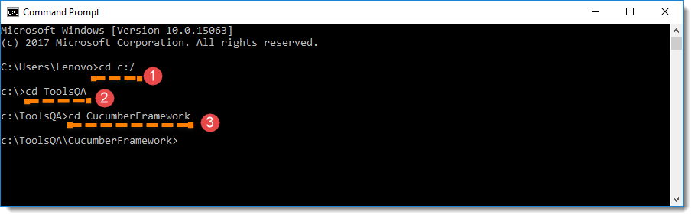
Run Test from Command Line
Open the Command prompt and cd until the project root directory (contain the POM.xml file).
Run the command in the command prompt: mvn test
Note: mvn test runs Cucumber Features using Cucumber’s Junit Runner. The @RunWith(Cucumber.class) annotation on the TestRunner class tells Junit to kick off cucumber.

Slide 7
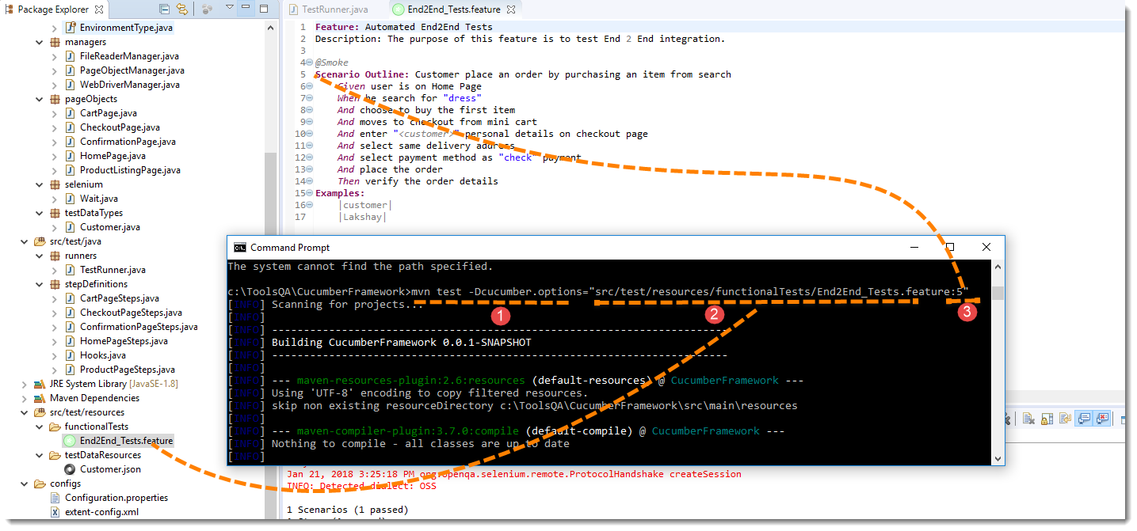
Overriding Cucumber Options
If we want to override the configurations mentioned in the Runner, then we need to use following command: mvn test –Dcucumber.options=“Your Options”
If we want to run single Scenario from the cmd, this is how we specify:
Mvn test –Dcucumber.options=“feature file path” + line number of the scenario”

Slide 8
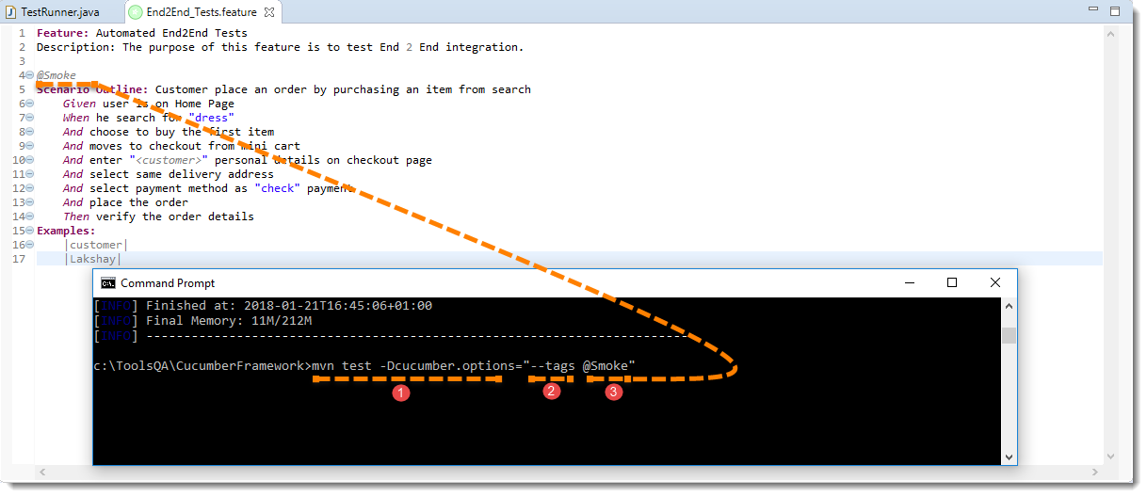
Overriding Cucumber Options
If you want to run the test cases associated to Tags, this is how we specify:
mvn test –Dcucumber.options=“-tags @tagName”

Slide 9
Overriding Cucumber Options
Pass multiple options at once
mvn test –Dcucumber.options=“some thing” –Dcucumber.options=“something” –Dcucumber.options=“something”
Example:
mvn test -Dcucumber.options=”src/test/resources/functionalTests/End2End_Tests.feature” -Dcucumber.options=”–tags @Smoke”

Slide 10

BROWSER PROFILE
Copyright© 2018 by Khanh Tran at Testmaster.vn

Slide 11
Capabilities & ChromeOptions
Capabilities are options that you can use to customize and configure a ChromeDriver session.
On java we can use ChromeOptions class to pass these options to driver.
Example:
ChromeOptions options = new ChromeOptions();
options.addExtensions(new File("/path/to/extension.crx"));
ChromeDriver driver = new ChromeDriver(options);
To see all options, we can find from: http://chromedriver.chromium.org/capabilities

